Slide 1
Knime Analytics Platform – Sales Analytics
LAB-9

Slide 2
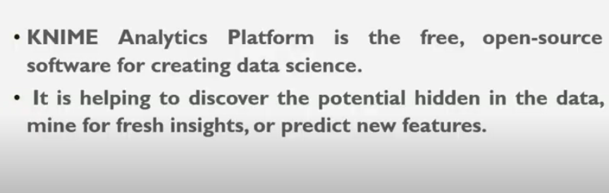

Slide 3
https://www.knime.com/
Click download

Slide 4
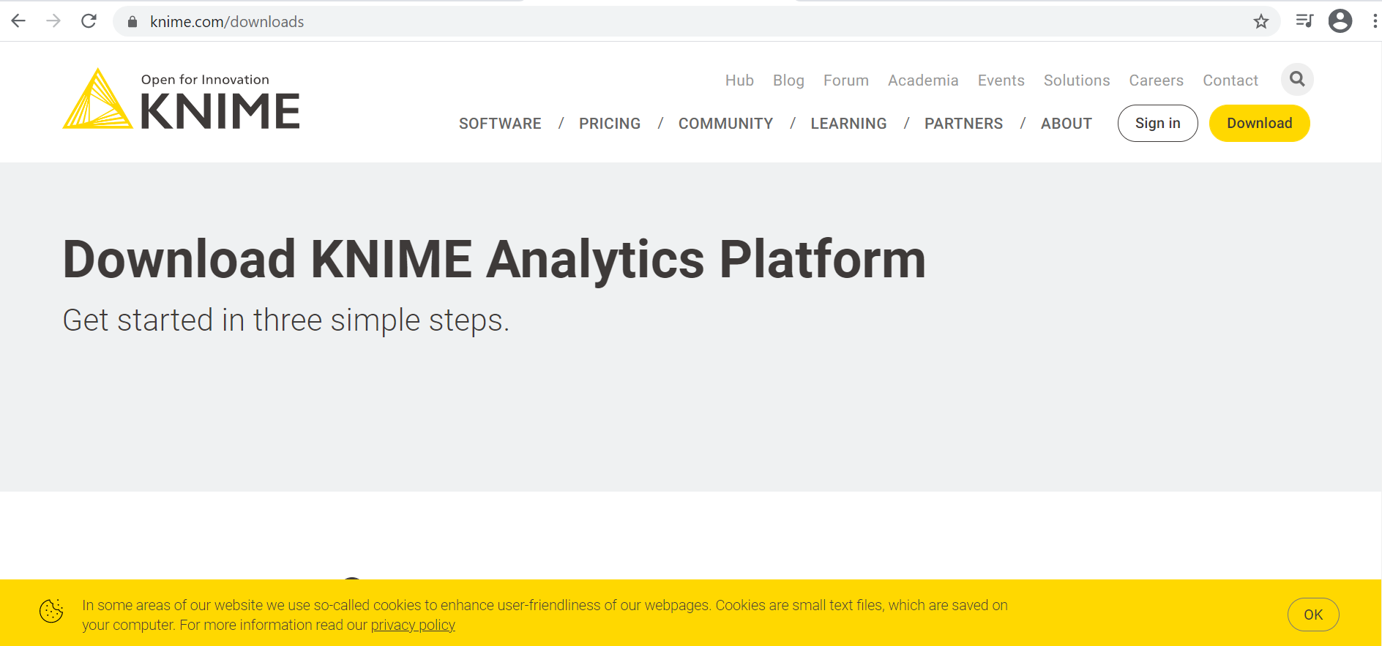

Slide 5
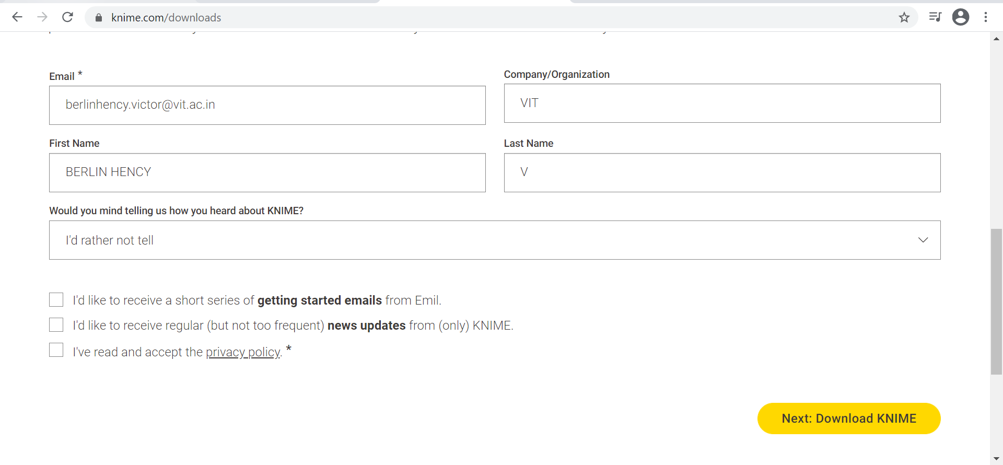
Click Next:Download KNIME

Slide 6
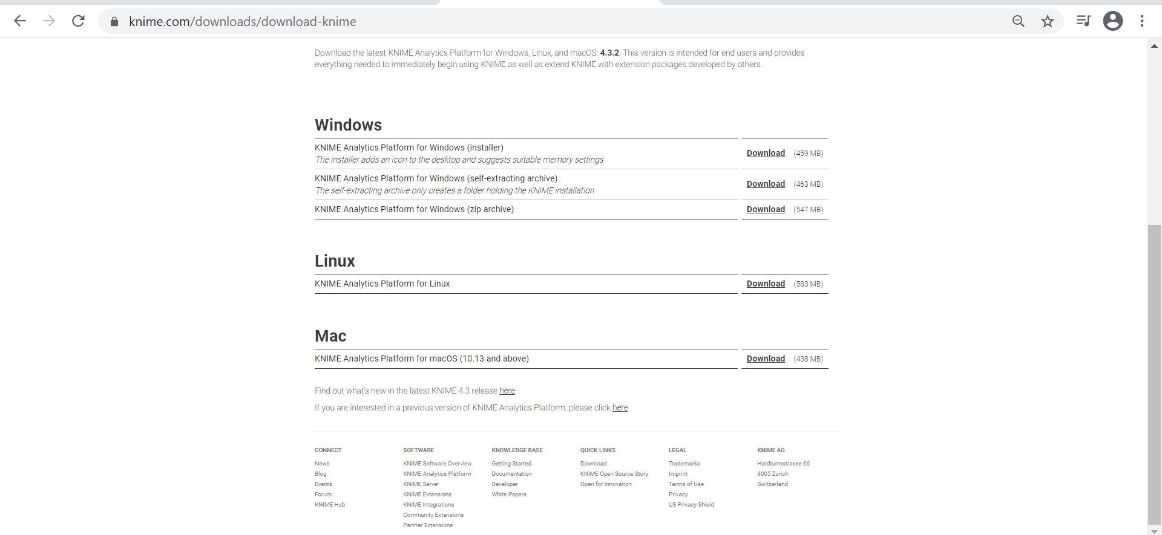

Slide 7
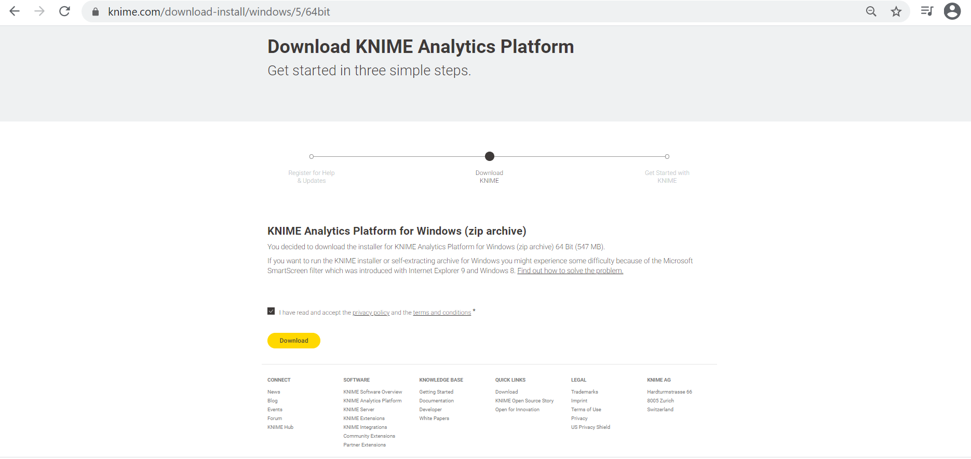

Slide 8
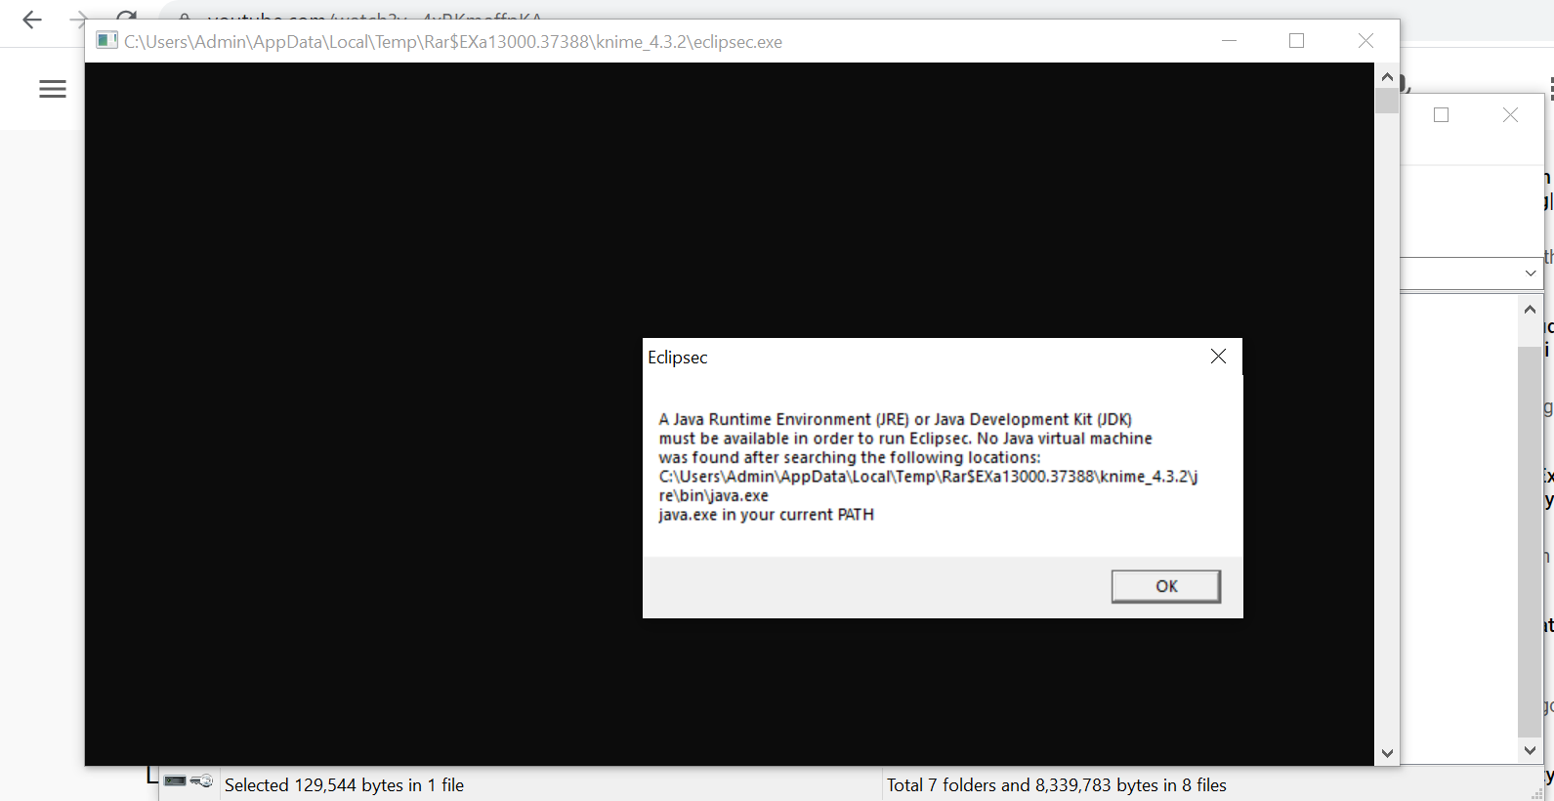
Unzip and double click ECLIPSEC.EXE

Slide 9
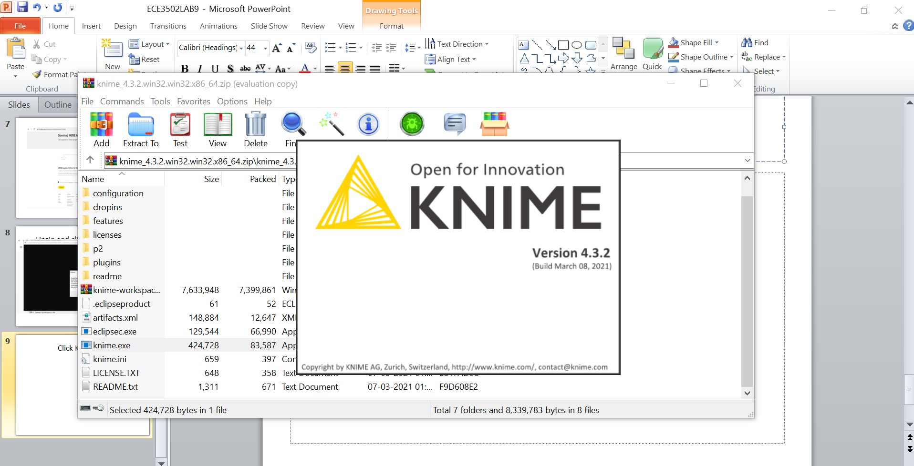
Click Knime.exe

Slide 10
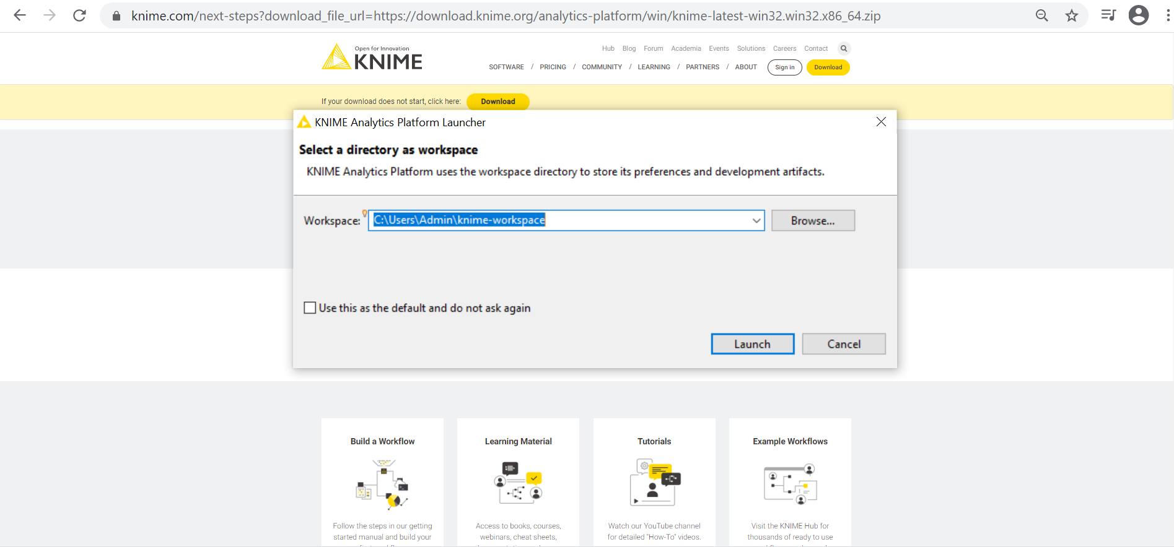
Click Launch

Slide 11
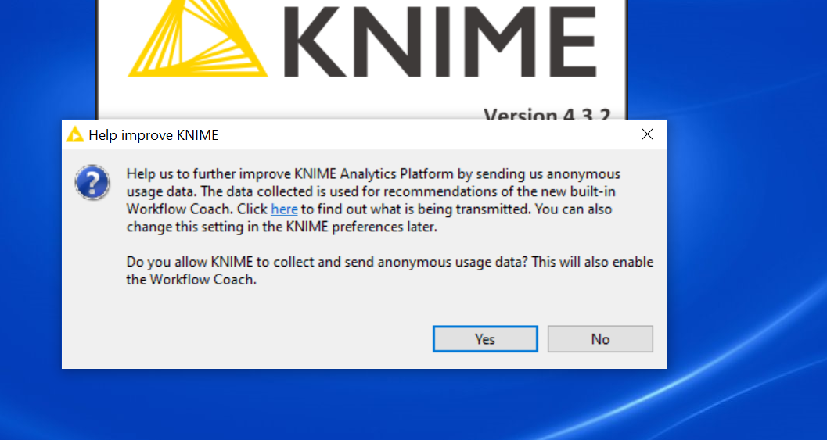
Click Yes

Slide 12
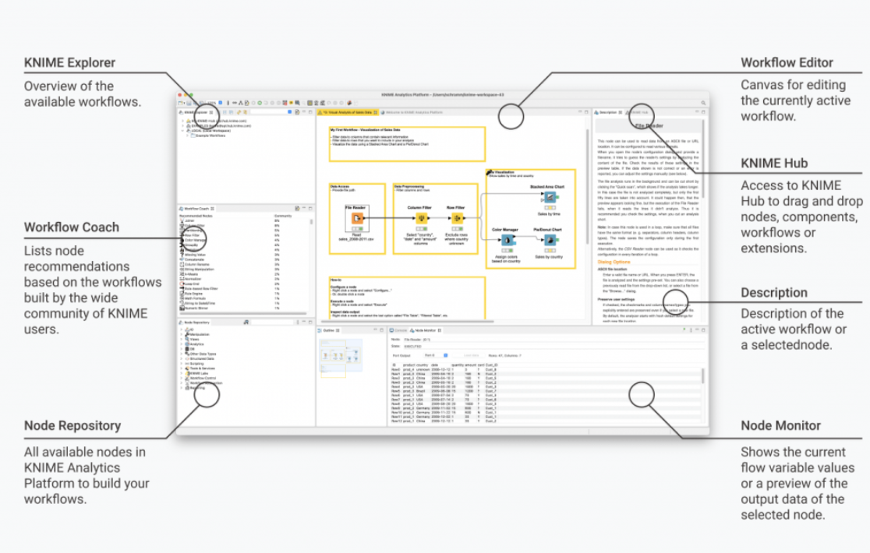

Slide 13
https://www.knime.com/getting-started-guide

Slide 14
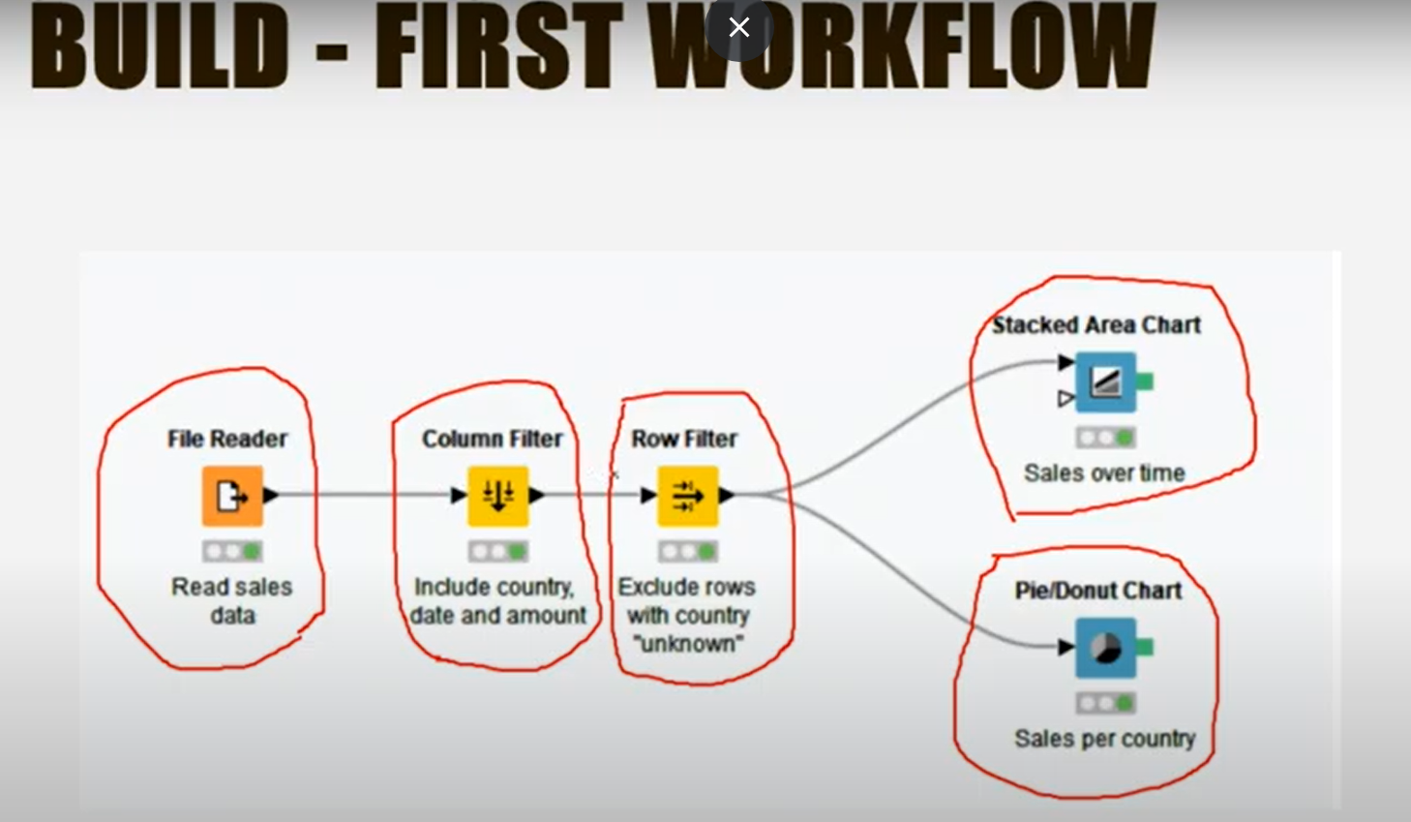

Slide 15
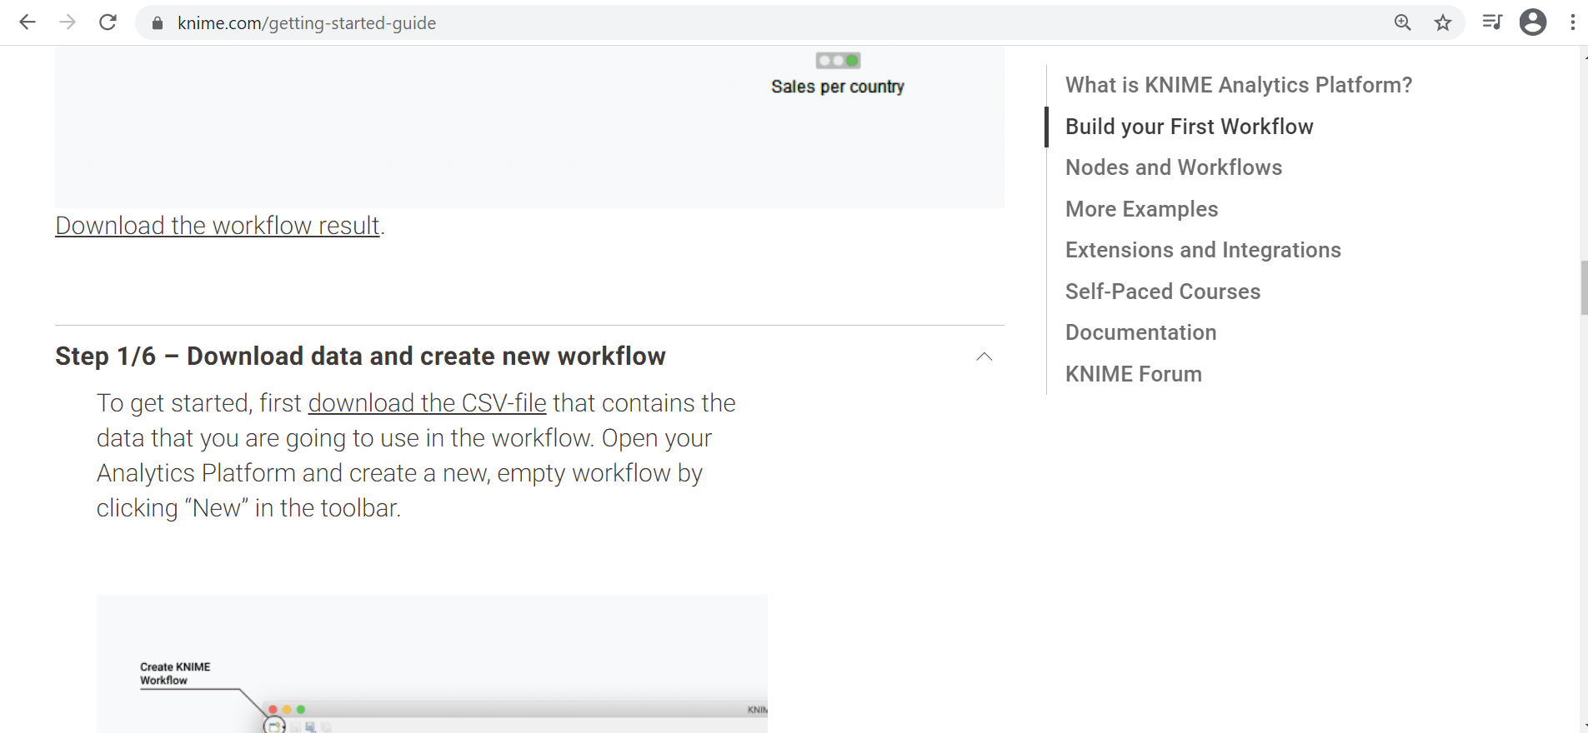

Slide 16
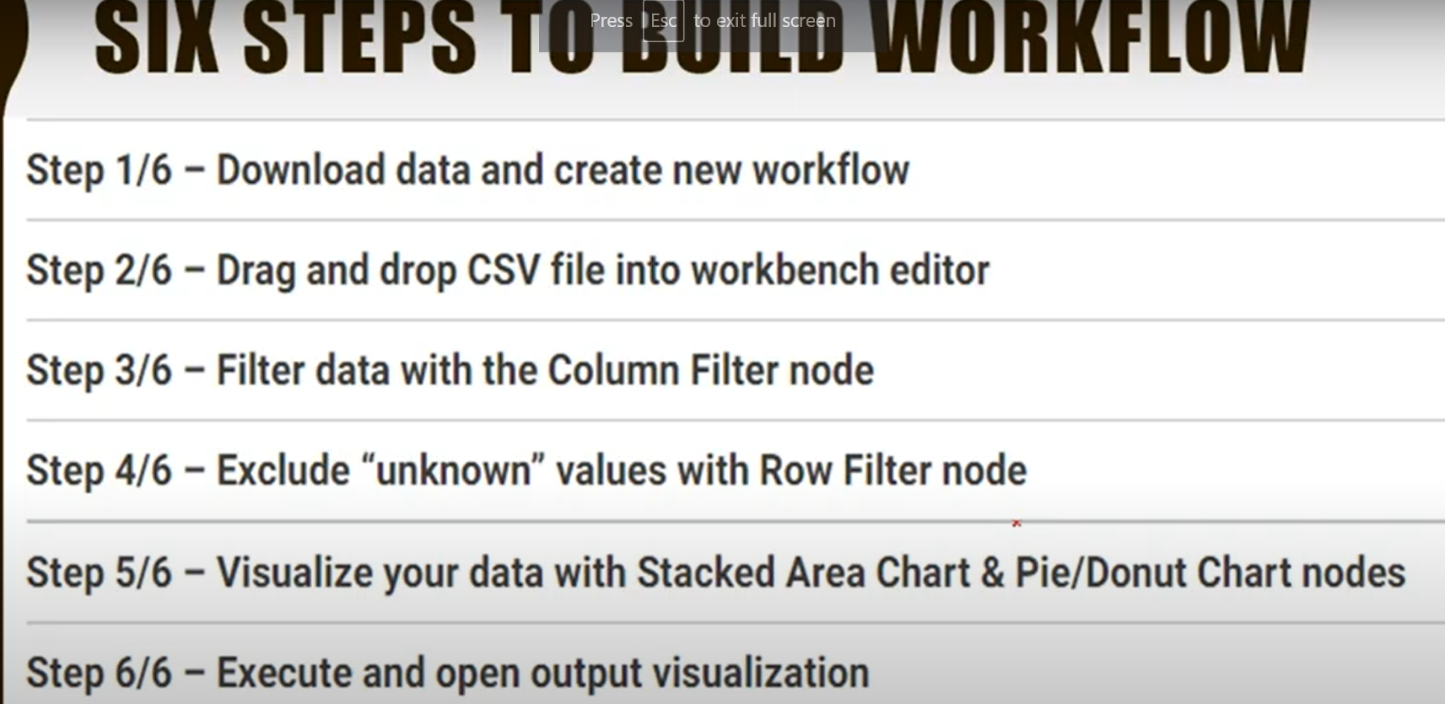

Slide 17
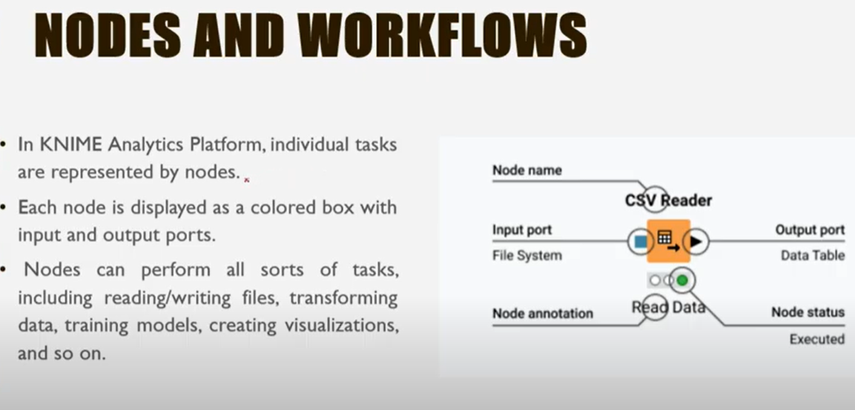

Slide 18
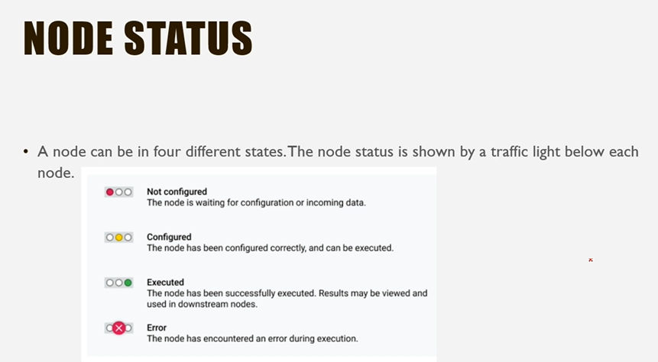

Slide 19
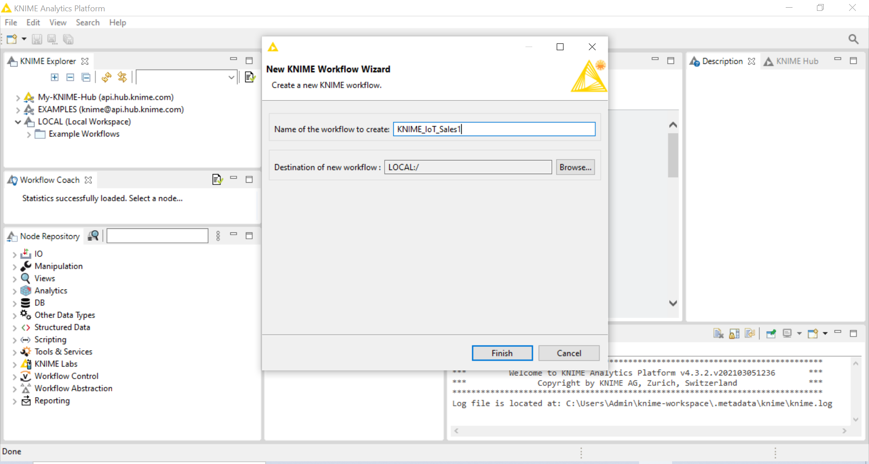

Slide 20
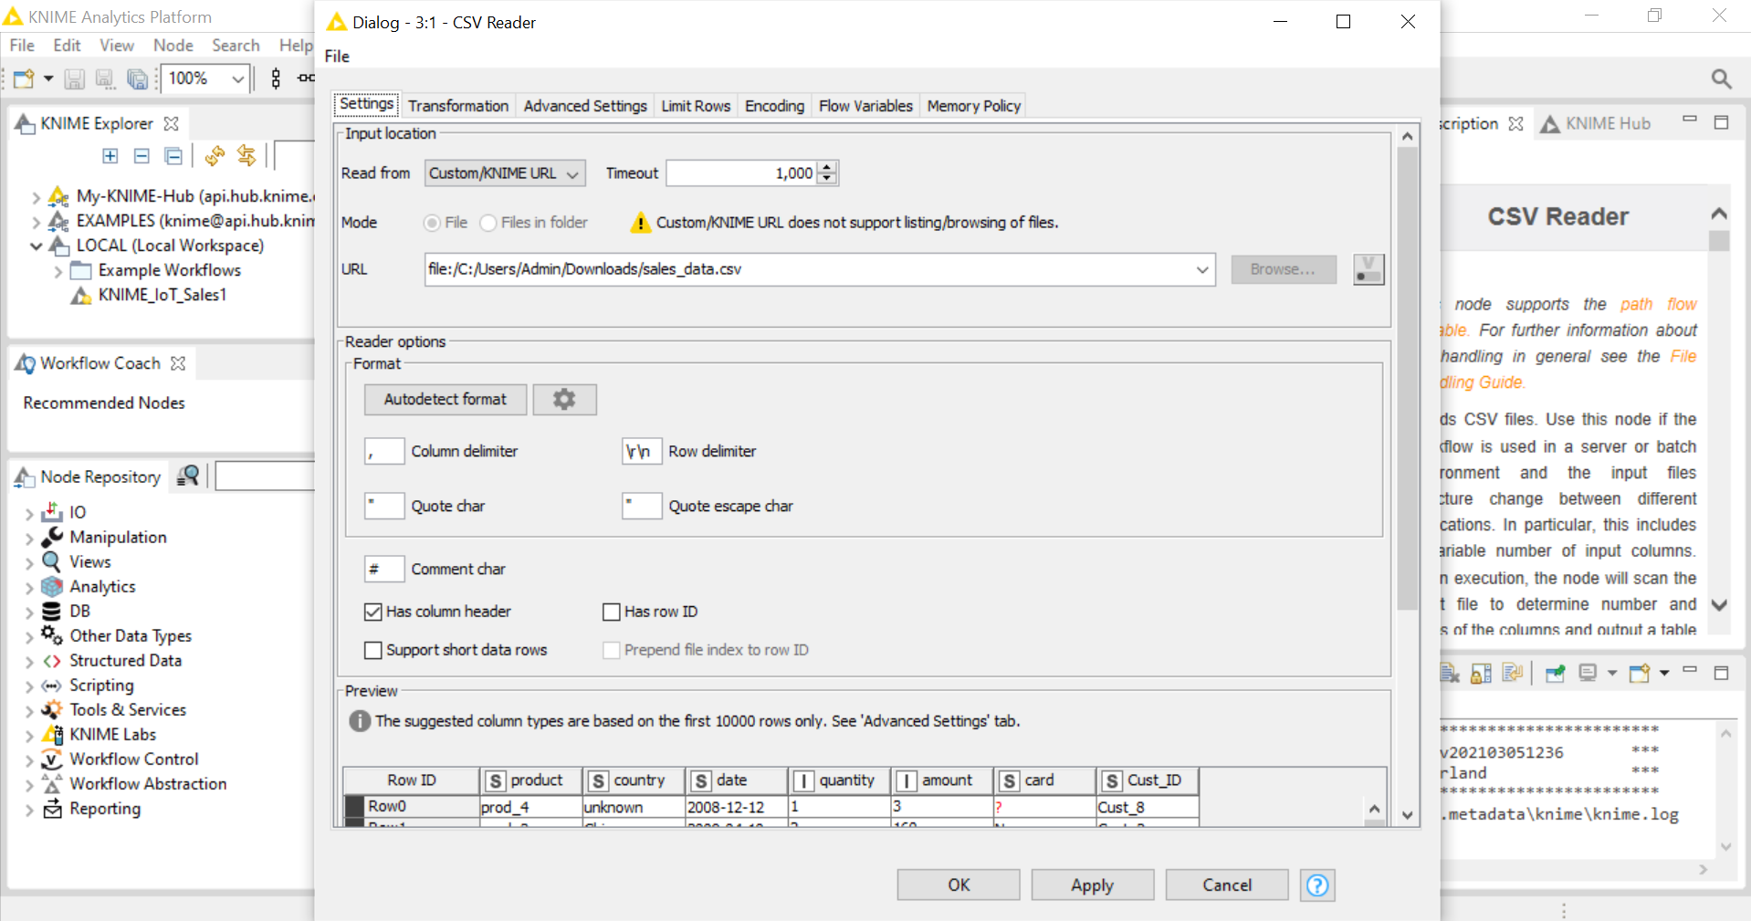
Drag sales_data from downloads and place it in workspace

Slide 21
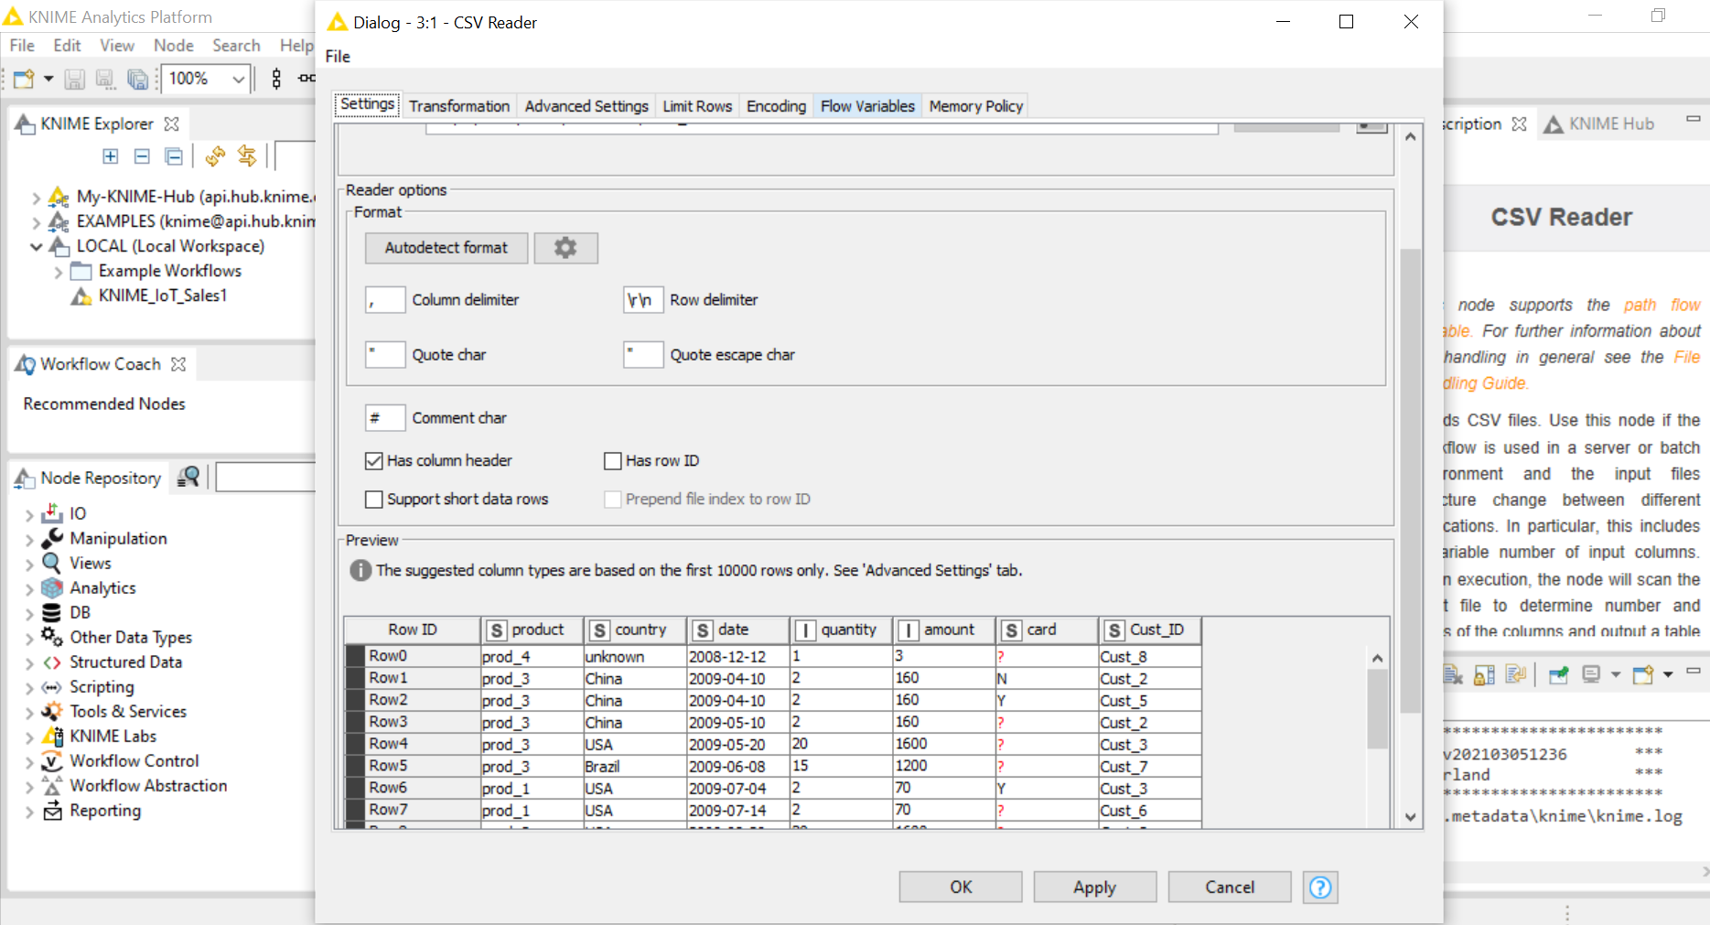
Click ok

Slide 22
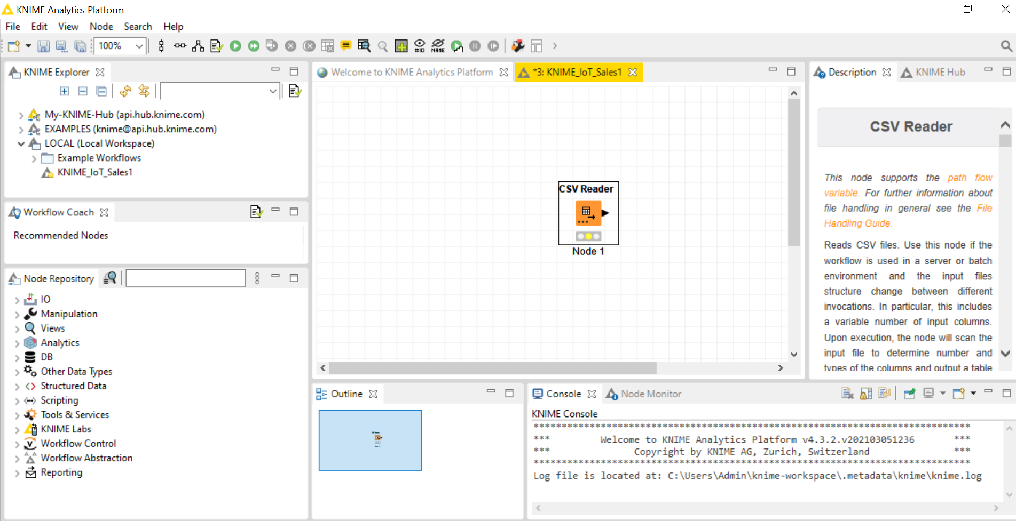
Right click on CSV Reader and execute

Slide 23
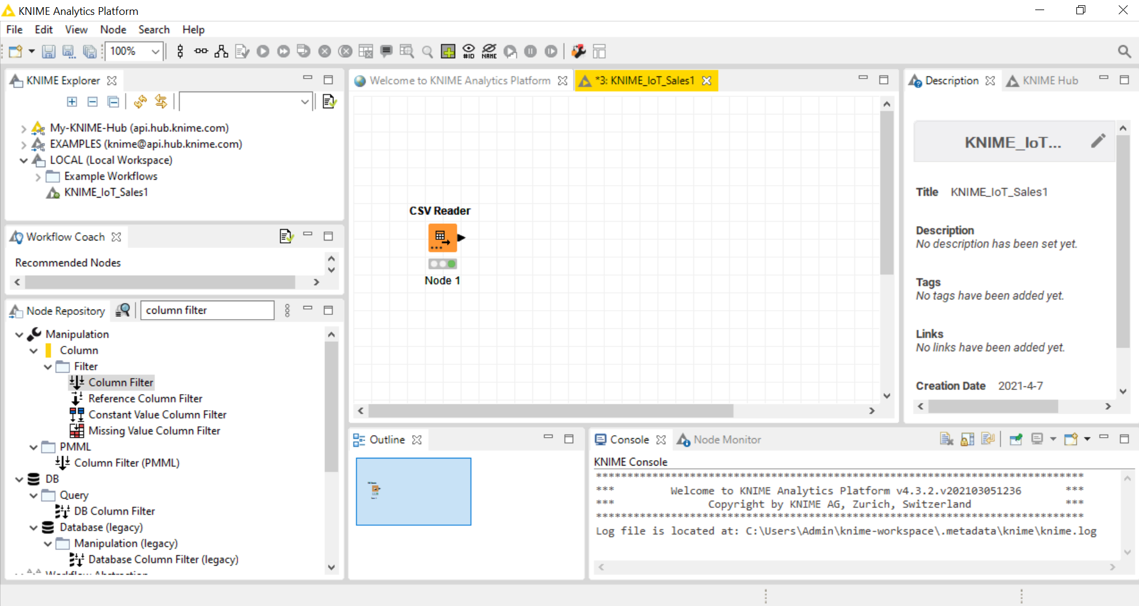

Slide 24
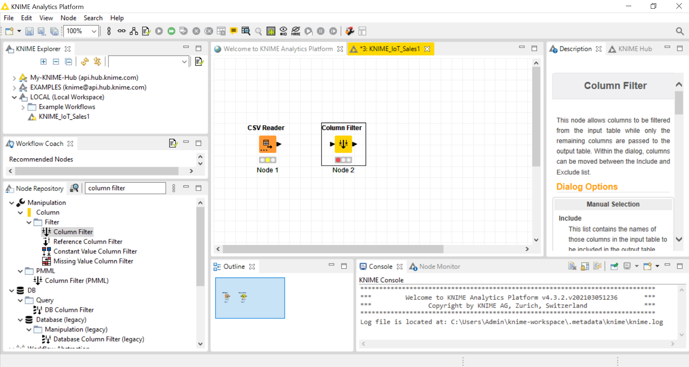
Type coloumn filter in Node Repository Drag and place it

Slide 25
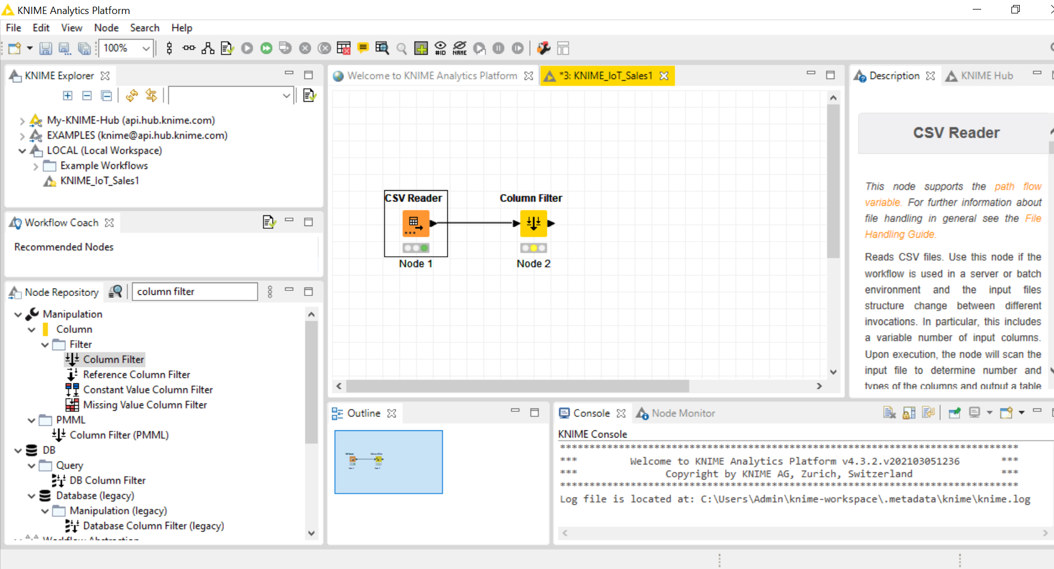
Connect

Slide 26
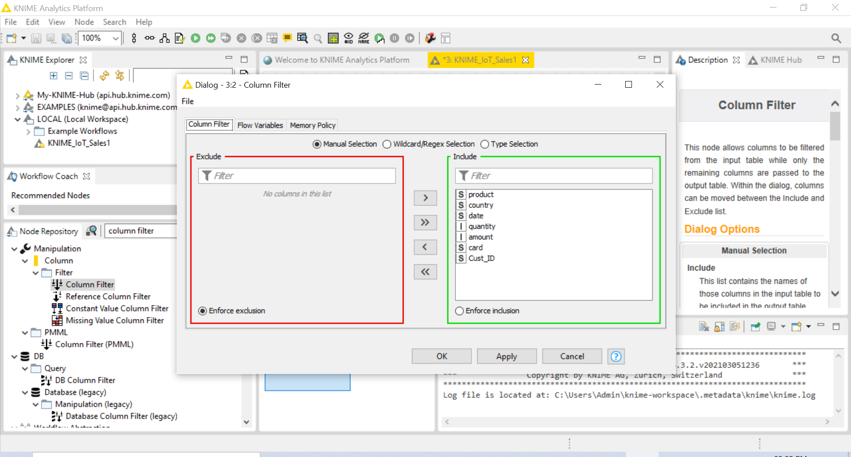
Right click and configure column node

Slide 27
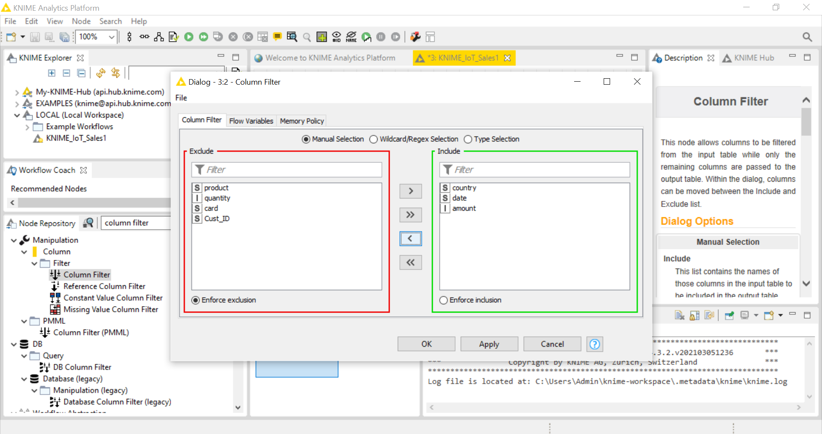
Exclude what is not needed and click ok

Slide 28
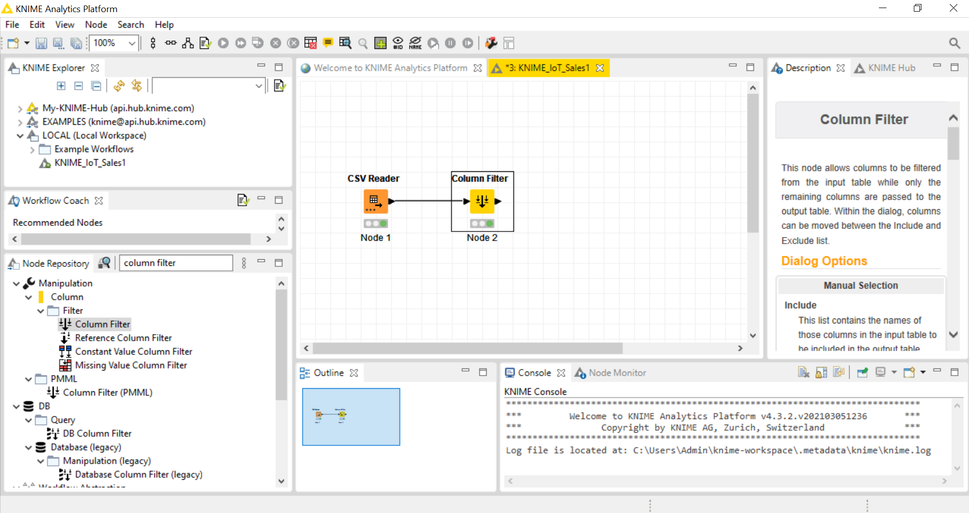
Right click and execute column filter

Slide 29
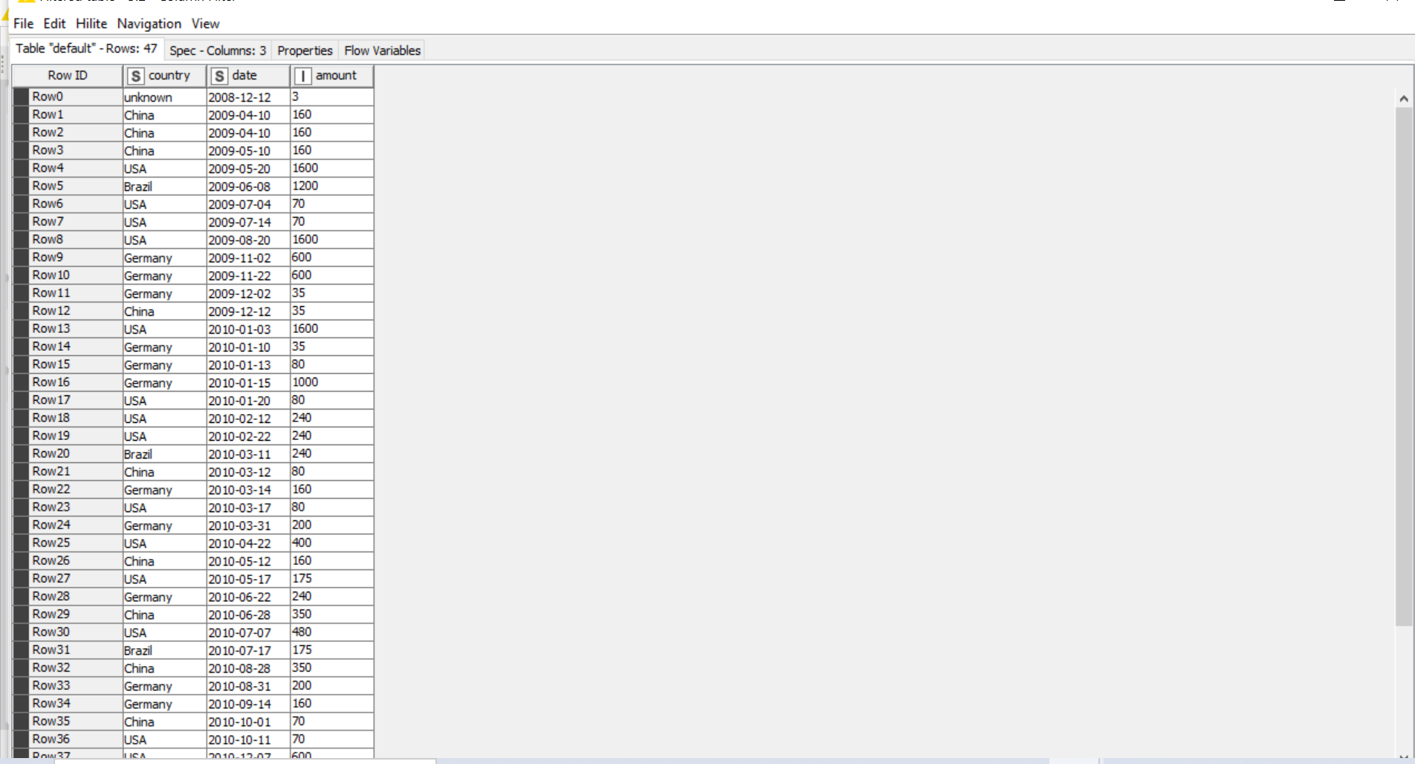
Right click column filter and click Filtered Table

Slide 30
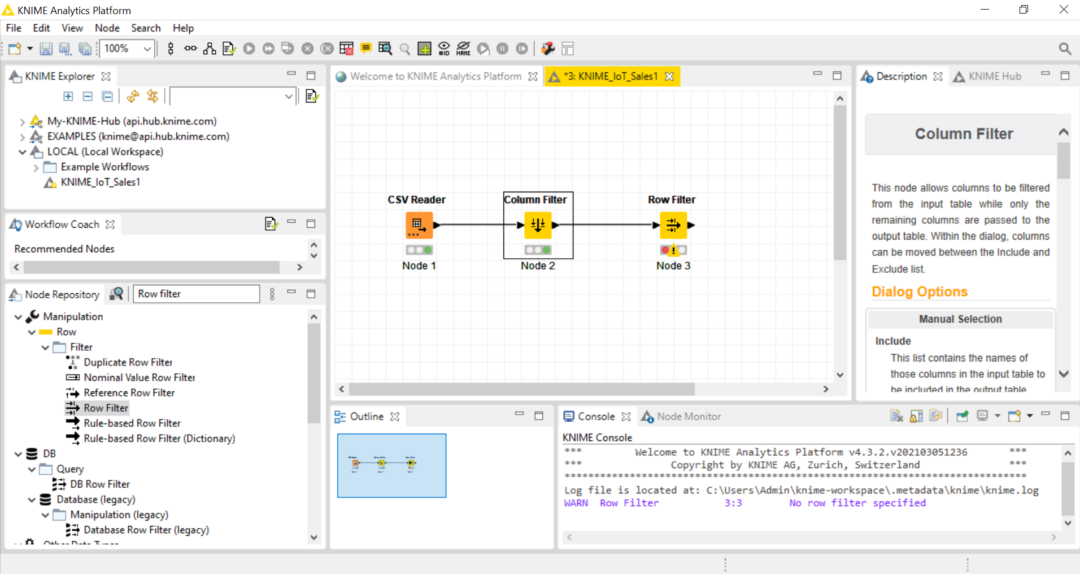
Drag Row filter and place and connect

Slide 31
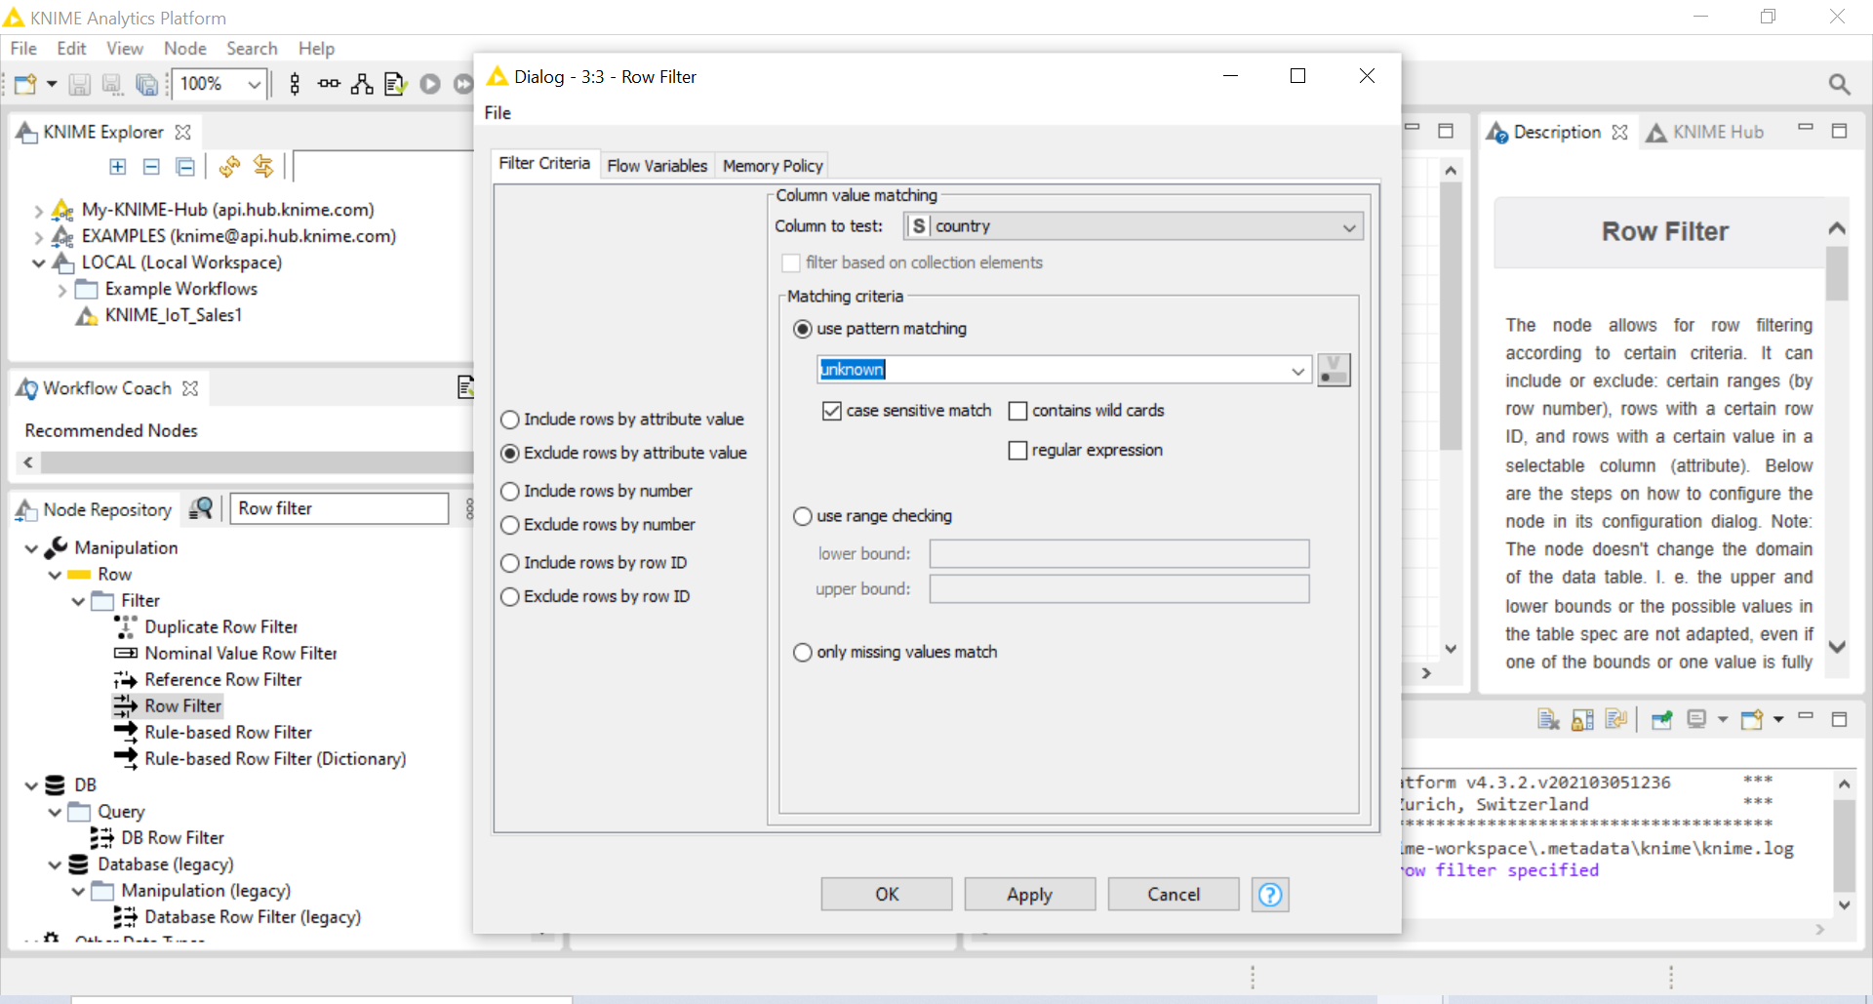
Right click row filter and configure

Slide 32
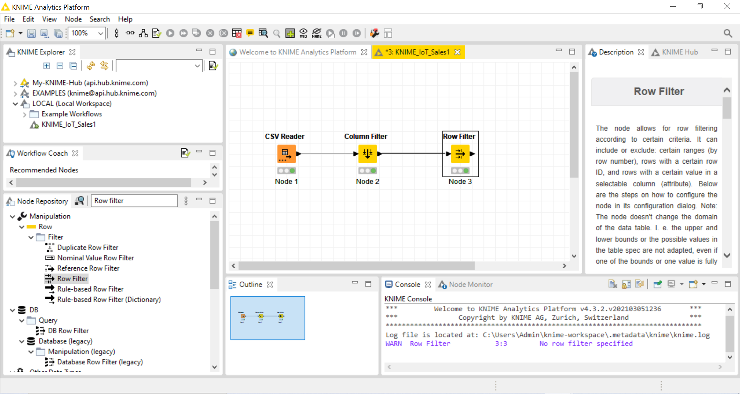
Right click Row Filter and execute

Slide 33
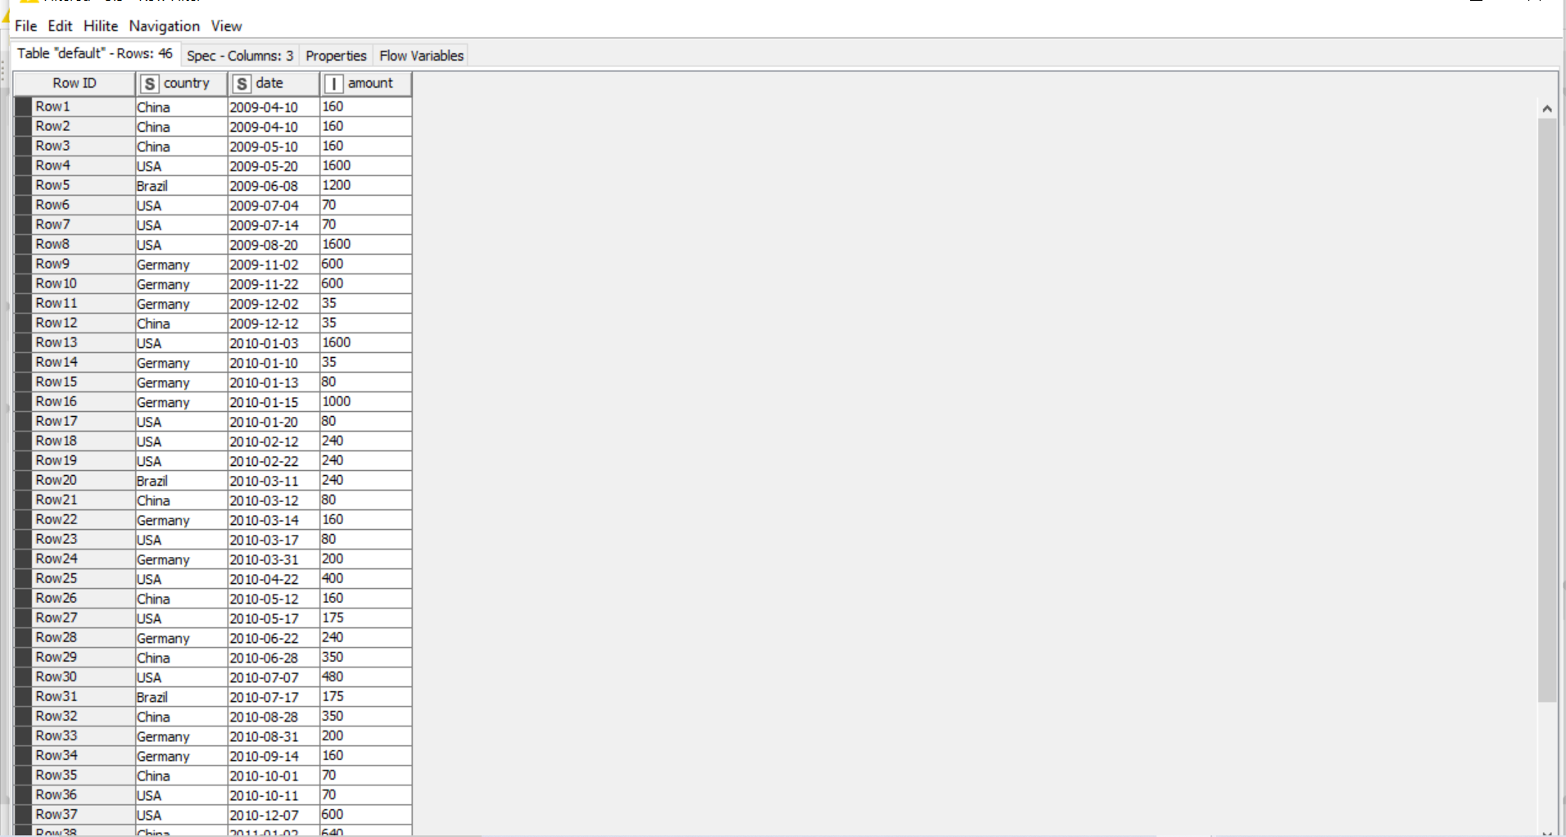
Right click Row Filter and click filtered Row 0 with unknown data is removed

Slide 34
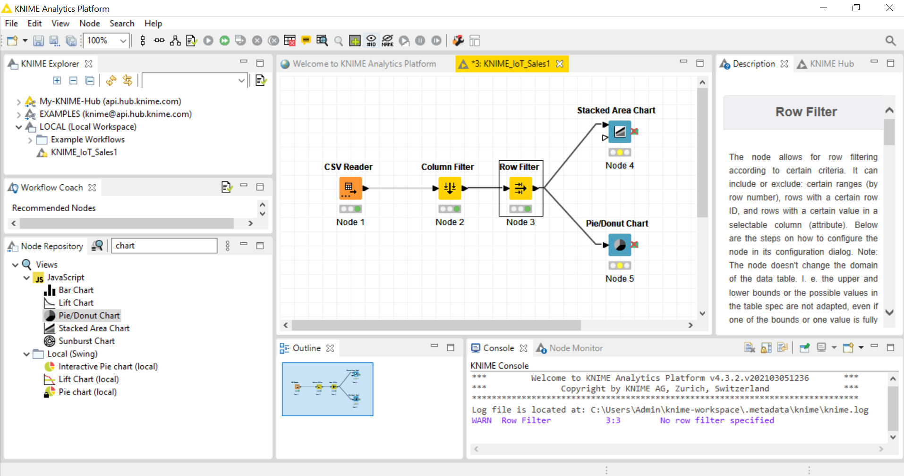

Slide 35
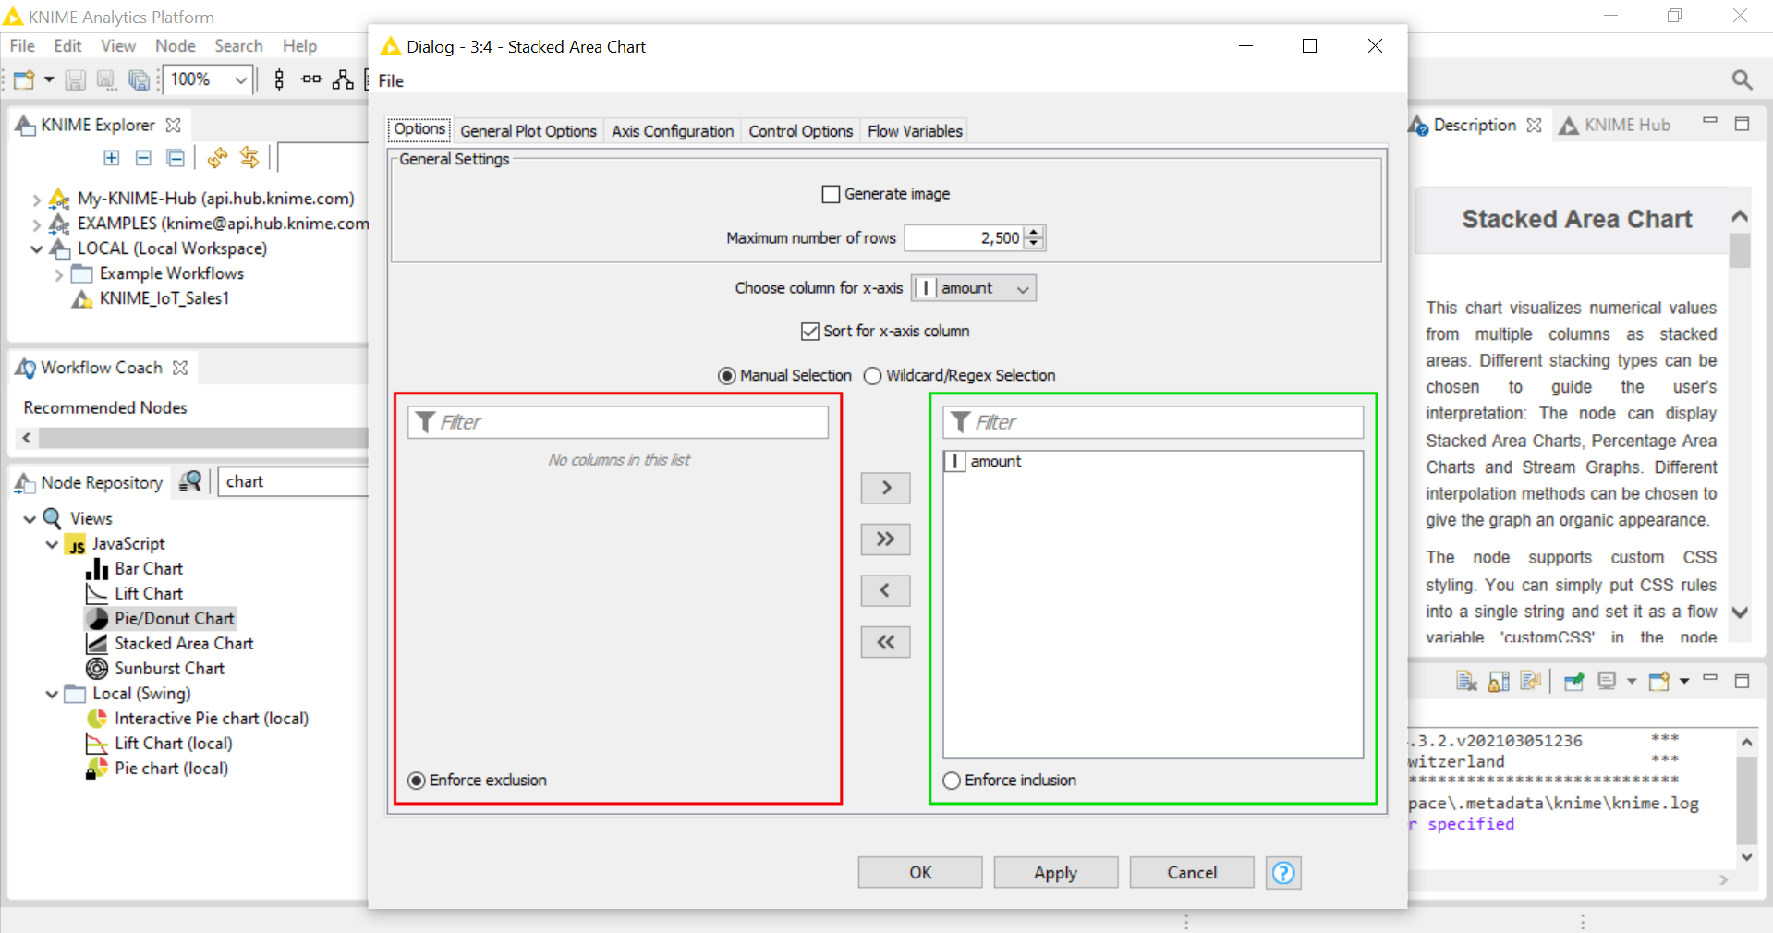

Slide 36
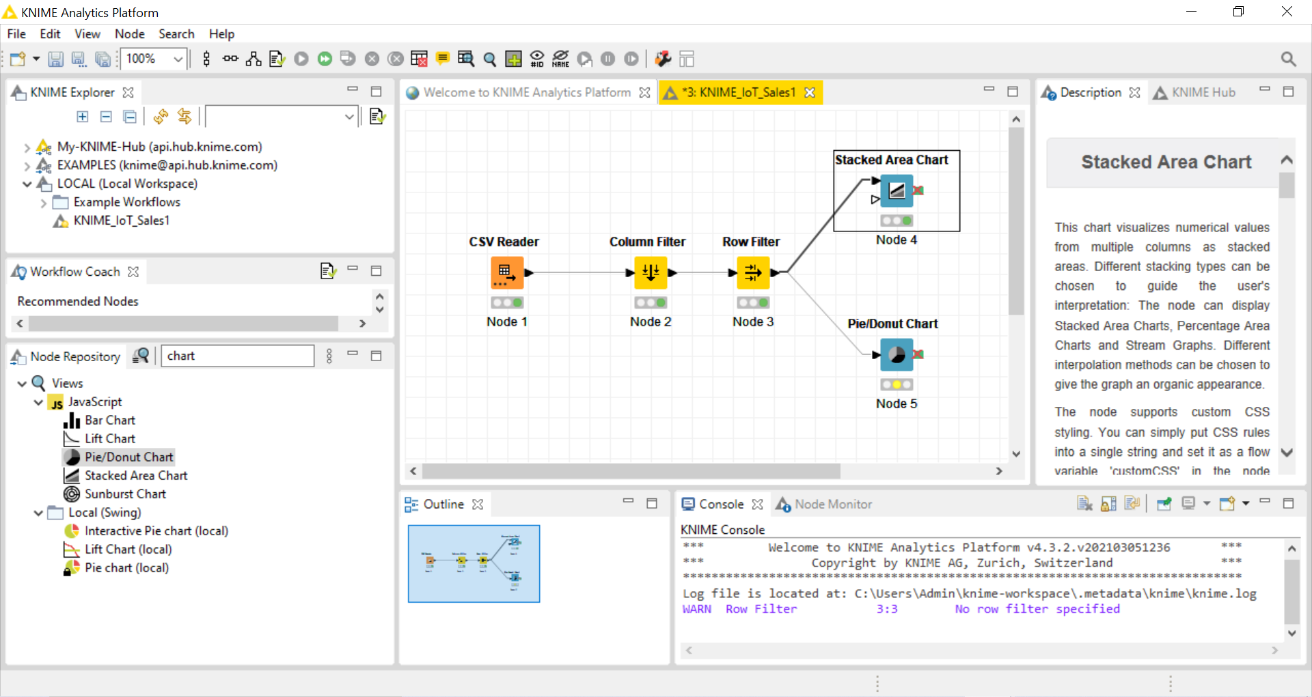
Execute and open view

Slide 37
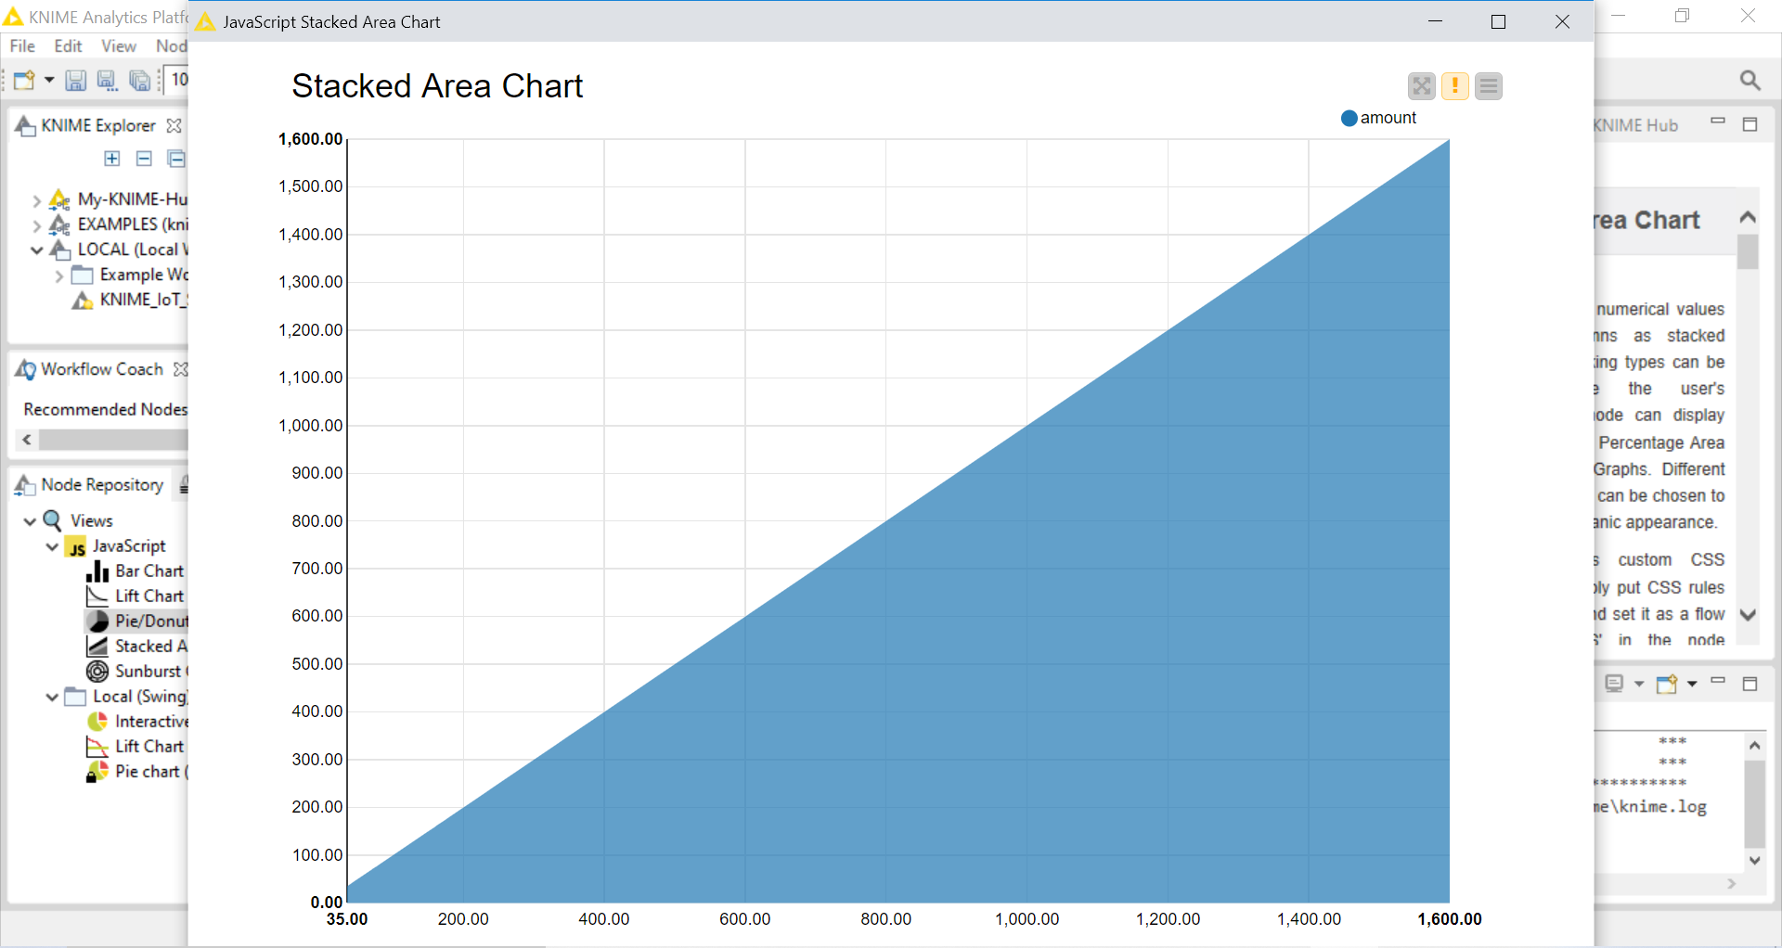

Slide 38
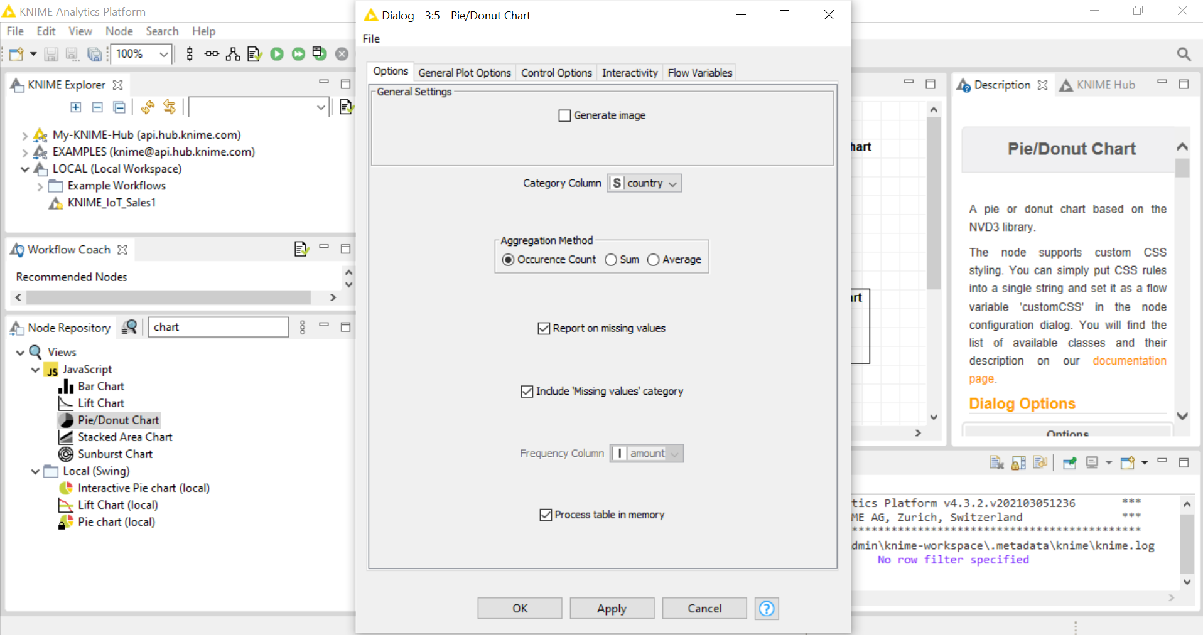
Configure Pie Chart

Slide 39
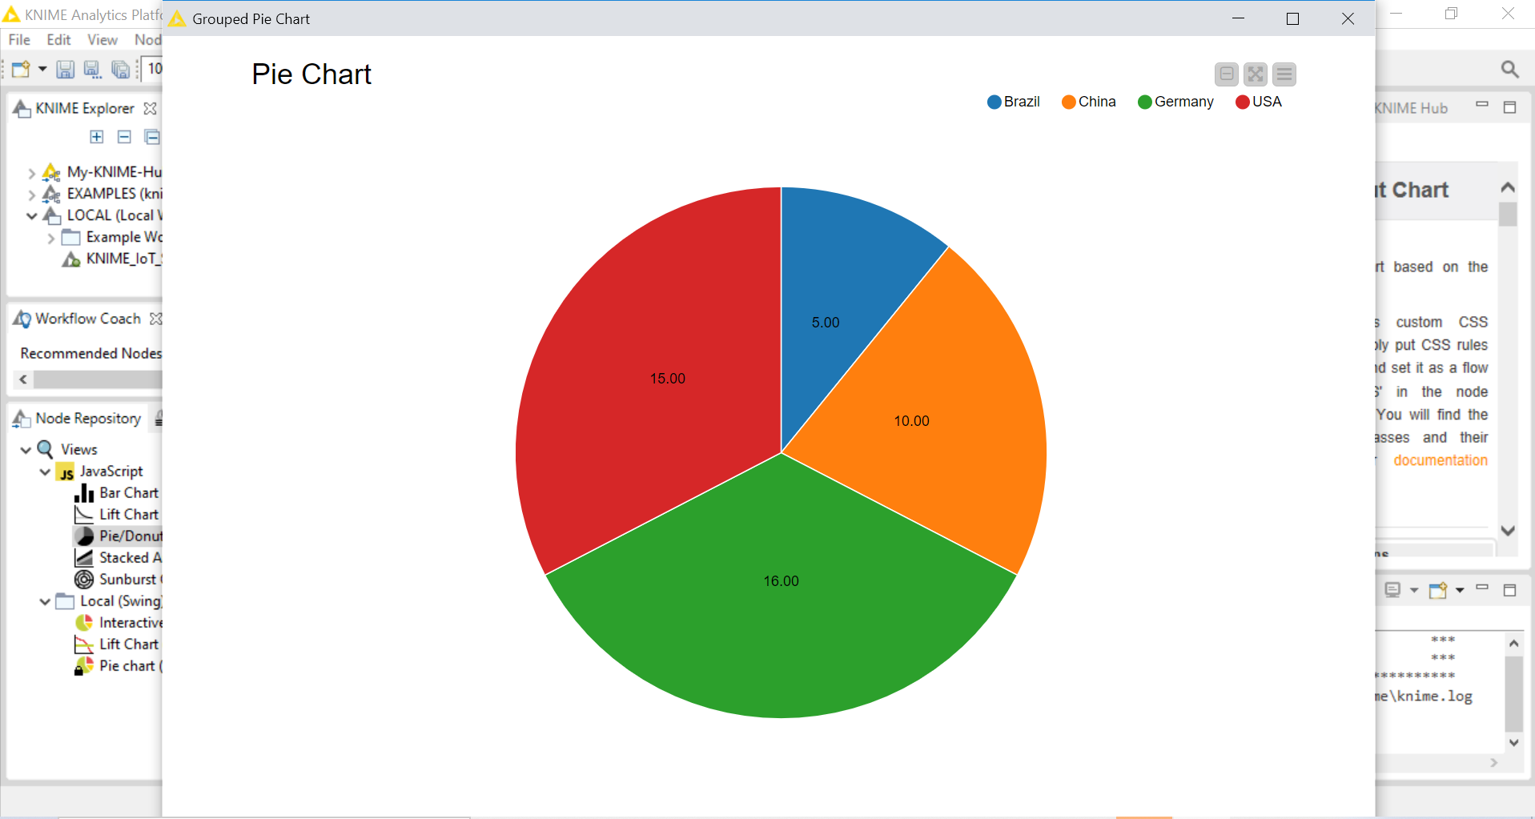
Execute and open view

Slide 40
Thank You

